Slide 1
A388 Safe Passageway
Provision of a safe route for cyclists and pedestrians between Callington and Saltash

Slide 2
Objectives
Minimize the requirement for cyclists and pedestrians to share tarmac on the A388 with motorized vehicles.
Provide a route that encourages A388 commuters to consider greener/healthier alternatives to motorized transport.
Link Callington to the current Saltash – Plymouth City Centre cycle route.

Slide 3
Constraints
Keep distance to a minimum
If the journey increases significantly in length, cyclists and pedestrians won’t use the alternative route.
Minimize “Give Way” and “Stop” junctions
If the route requires cyclists to repeatedly stop and dismount, they will be discouraged.
Avoid switching sides of the A388
Crossing over the busy A388 is undesirable and potentially very expensive (bridges, underpasses, etc).
Minimize gradient changes
A flat route provides the most efficient, quickest option for commuting cyclists.

Slide 4
Givens
The Broadmoor Farm development will provide a Safe Passage for pedestrians and cyclists from Roodes Corner (the Cardinal’s Hatt) to Saltash.
Where wide verges exist beside the A388, they are council owned and would not require procurement or 3rd party consent to use them.
Lanes and quiet B roads are considered suitable, providing a reasonable surface quality is maintained for cyclists.

Slide 5
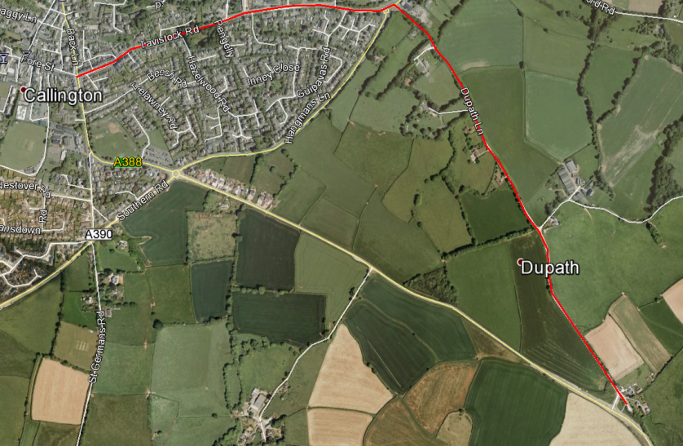
Part 1 – Callington to Ashton
Town Centre – Tesco – Pengelly Garage – Dupath – Dupath Junction. Distance: 2.26km

Slide 6
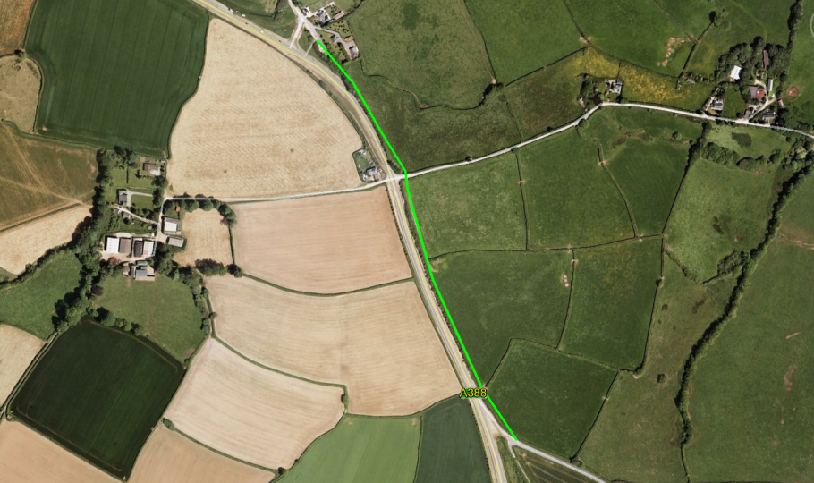
Part 2 – Ashton to St Dominick
Dupath Junction – Ashton Lane – St Dominick Junction. Distance: 0.70km

Slide 7
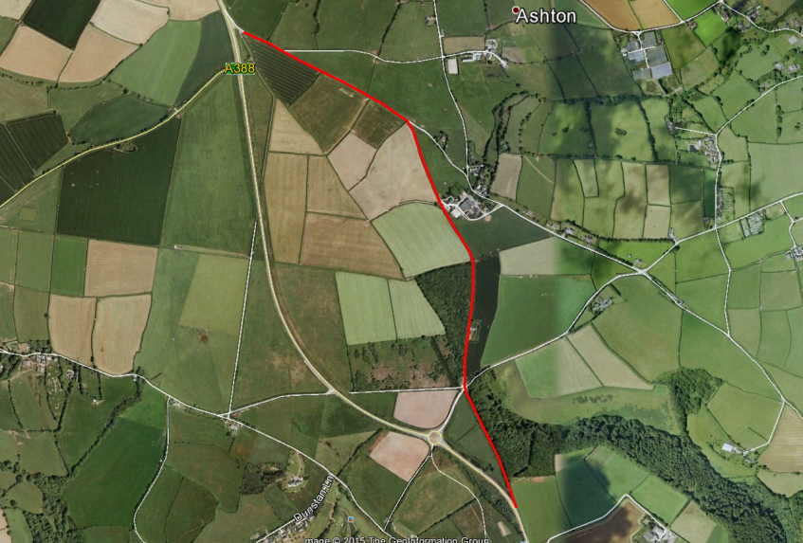
Part 3: St Dominick – St Mellion North
St Dominick Junction – Tipwell – Verigo Cross - Golf Club Old Entrance. Distance: 2.16km

Slide 8
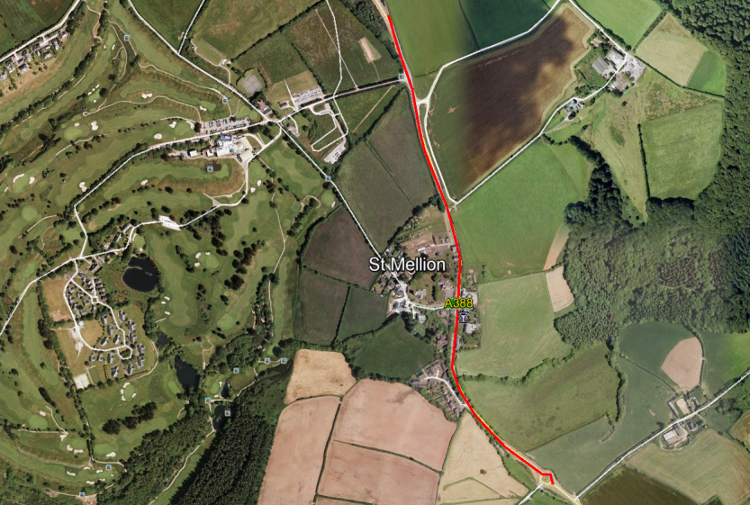
Part 4: St Mellion North - South
Golf Club Old Entrance – St Mellion Village – Polborder Roundabout. Distance: 1.2km
On-road route unless St Mellion is bypassed or a better alternative route is identified.

Slide 9
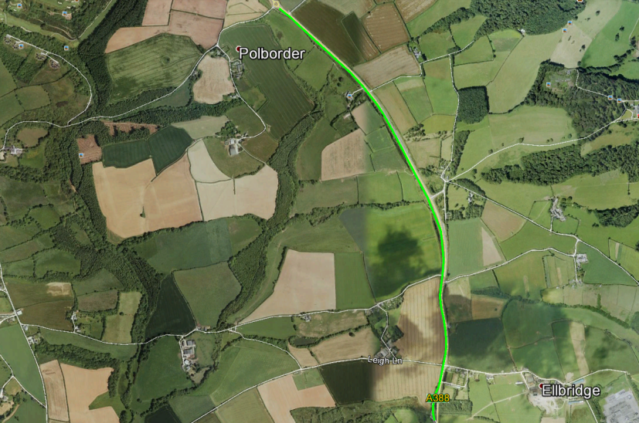
Part 5: St Mellion – Hatt Layby
Polborder Roundabout – A388 verge – Hatt Layby. Distance: 2.43km
Sufficient verge exists on West side of highway to create a dedicated cycle lane.

Slide 10
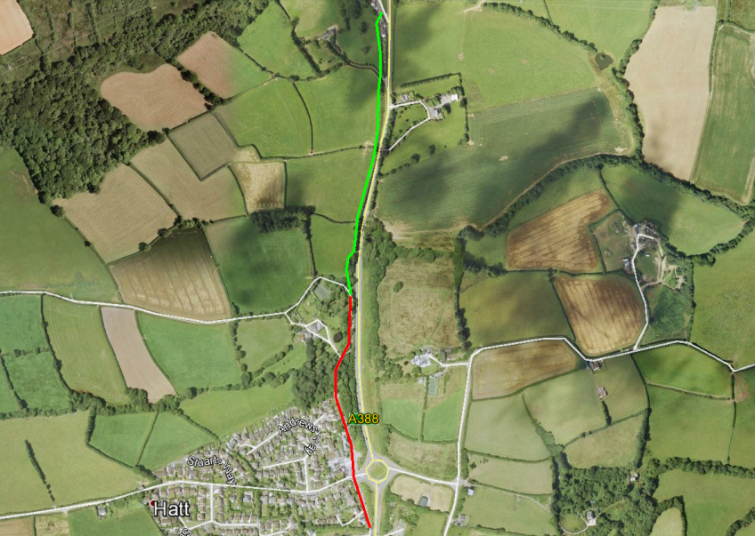
Part 6: Hatt Layby – Hatt Roundabout
Hatt Layby – Hatt Roundabout. Distance 0.6KM Off-road + 0.5KM On-Road

Slide 11
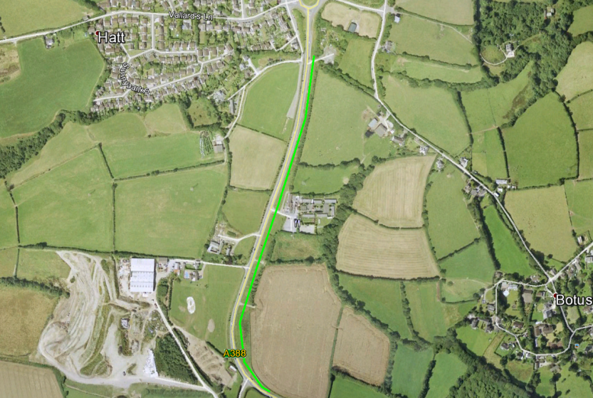
Part 7: Hatt Roundabout – Roodes Corner
Hatt Roundabout – Roodes Corner. Distance: 0.83km
Sufficient verge exists on East side of highway to create a dedicated cycle lane.

